Slide 1

Prototyping and mockups
roberto.figlie@phd.unipi.it

Slide 2
Lesson outline
Mockups
Prototypes
Fidelity
Scope
Techniques
Mockups vs Wireframes vs Prototypes
From Wireframes to Prototypes
Figma basics

Slide 3
Mockups

Slide 4
Mockups
A mockup is a high-fidelity representation of the product that includes more visual detail and design elements than a wireframe: it is a more polished and refined version and it is used to test and refine the look and feel.
A realistic visual design that resembles what the new product or functionality will look like.

Slide 5
Mockups
Creating a mockup involves adding visual details and design elements to a wireframe, such as typography, color schemes, and images. Mockups can be created only digitally using design software, such as Sketch, Adobe XD (or Photoshop, just like the good old times), or Figma.
So, mockups can be used to refine and showcase visual design elements, from the placement of images and icons to the overall style and branding of a product or service. But is essential to note that while mockups may resemble the final product, they lack the functionality required to perform meaningful testing or gather insightful feedback. This is because mockups are static representations of the design and lack the interactive elements that are necessary for usability testing.

Slide 6
Mockups
When and why?
UX/UI teams commonly rely on mockups during the design process to showcase their ideas to stakeholders and clients. These mockups serve as visual aids that help UX professionals communicate their design concepts and features more effectively. In addition, mockups are helpful for certain types of usability studies where feedback is needed on the overall look and feel of the design (5-seconds test, first-click test).

Slide 7
Prototypes

Slide 8
What is a Prototype?
A prototype is an experimental and early sample of a design that allows users to visualize and interact with it before a final product is developed. Teams build prototypes of varying degrees of fidelity to capture design concepts and test on users.
So, prototyping is the process in which design teams ideate, experiment with, and bring concepts to life. Is the phase in which design teams implement ideas into tangible forms from paper to digital.
What is Prototyping? | IxDF (interaction-design.org)

Slide 9
Why do we need a Prototype?
We never (or at least rarely) get things right the first time!
Prototyping allows designers to test their ideas on users and refine their designs based on feedback. This can help save time and resources by identifying potential issues early on.
With prototypes, you can validate your designs so to release the right product.

Slide 10
Why do we need a Prototype?
Prototyping is an essential part of UX design that usually comes after ideation, where you/your team have created and selected ideas that can solve users’ needs.
Some advantages of creating a prototype include:
Providing a solid foundation for ideation and giving stakeholders a clear picture of potential benefits, risks and costs.
Changes can be made early in the process to avoid costly oversights and commitment to a single version.
User feedback on the prototype helps identify what works best and if an overhaul is needed.
Prototyping allows for experimentation with user needs and problems to gain insights into less obvious areas.
Stakeholders have a sense of ownership and emotional investment in the product’s success.
Time-to-market is improved by minimizing errors before product release.

Slide 11
Prototypes
“They slow us down to speed us up. By taking the time to prototype our ideas, we avoid costly mistakes such as becoming too complex too early and sticking with a weak idea for too long.”
— Tim Brown, CEO & President of IDEO

Slide 12
Prototypes
In summary:
A prototype is a design solution candidate that addresses specific problems/needs.
With it, usability problems can be identified before committing to the development of the final design.

Slide 13
How do we do a Prototype?
The prototyping process involves selecting key features to test, creating a design prototype that exemplifies those features, and then testing it on users. There are many different methods for prototyping, ranging from paper sketches to digital versions.

Slide 14
prototype fidelity, scope and techniques

Slide 15
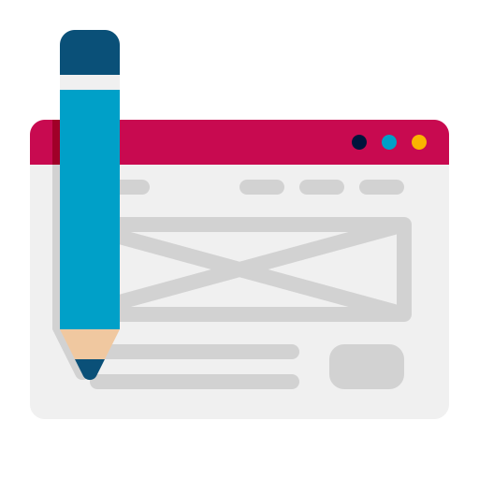
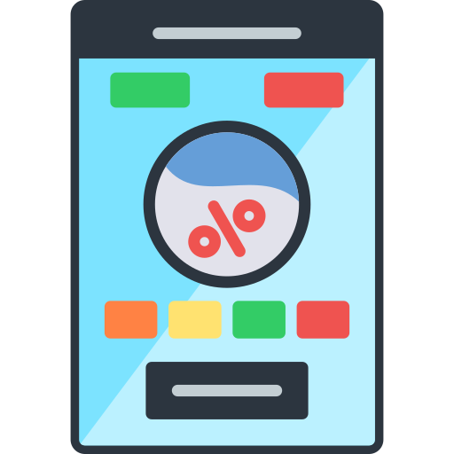
Prototypes fidelity
How much a prototype resembles the final product (in look, feel and function) is a matter of fidelity.
Generally there are 2 types of fidelities (plus another one).

Slide 16
Low-fidelity prototypes
Pros:
Usually done with pen & paper (cheap & disposable).
Connects the low-fidelity wireframes between them.
Can provide very simple interactions (if not any) and feel.
Done in less time.
Easier to modify (more iterations).
Encourages Design Thinking.
Cons:
Lack of realism (difficult for users to give feedback).
Results from early versions may be hard to apply.
May be too basic to reflect the user experience of the finished product.
Can oversimplify complex issues.
Lack of interactivity deprives users of direct control.
Users must imagine how they would use the product.
https://www.nngroup.com/articles/ux-prototype-hi-lo-fidelity/
https://www.interaction-design.org/literature/topics/prototyping

Slide 17
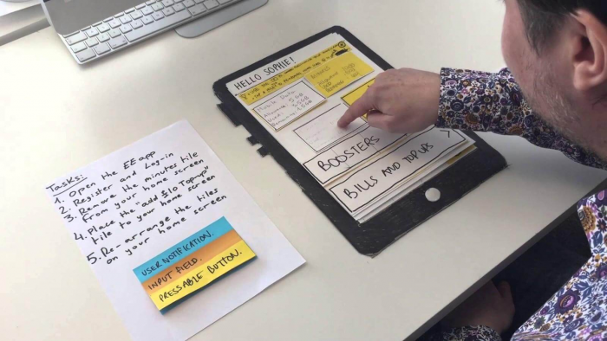
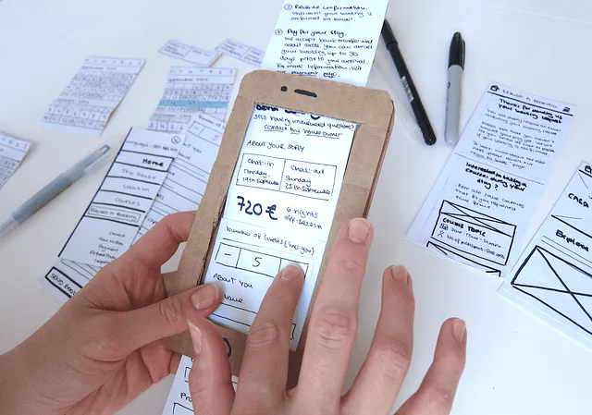
Low-fidelity prototypes
https://xd.adobe.com/ideas/process/prototyping/low-fi-and-hi-fi-prototyping/

Slide 18
High-fidelity prototypes
Pros:
Can be coded or developed in a specific software (Figma, XD, Sketch).
Gives a final-like feel.
You can test more elements (interactions, visual, text readability, etc.).
Engaging for all stakeholders.
Allows stakeholders to judge how well the prototype matches users’ needs and solves their problems
Testing yields more accurate and applicable results.
Cons:
Longer and costlier to create.
Users may focus on superficial details rather than content.
Designers may dislike making changes after hours of work.
Users may mistake the prototype for the finished product and form biases.
https://www.nngroup.com/articles/ux-prototype-hi-lo-fidelity/
https://www.interaction-design.org/literature/topics/prototyping

Slide 19
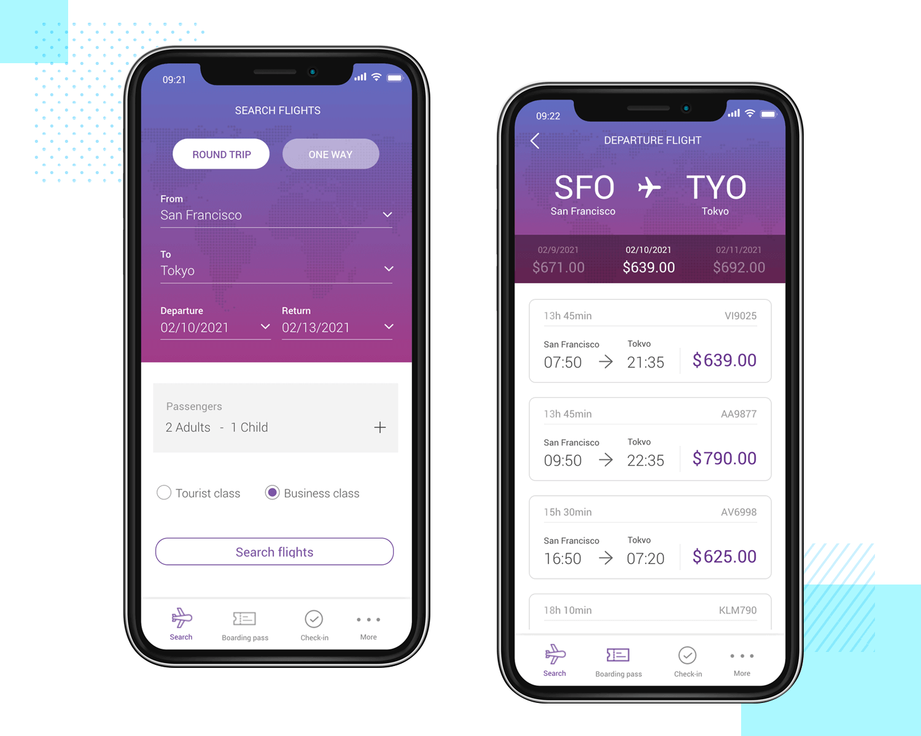
High-fidelity prototypes
https://www.justinmind.com/blog/low-fidelity-vs-high-fidelity-prototypes/

Slide 20
Finding the right balance: Mid-fidelity prototypes
Another possibility is given by mid-fidelity prototypes where you keep some of the benefits of using Low-fidelity and high-fidelity ones.
An example of a mid-fidelity prototype could be an advanced wireframe with some digital interactivity (i.e., adding interactions to wireflows).
However, you have to remember that the concept of fidelity is relative: you have to choose wisely what is best for you depending on the stage of design and features to test.

Slide 21
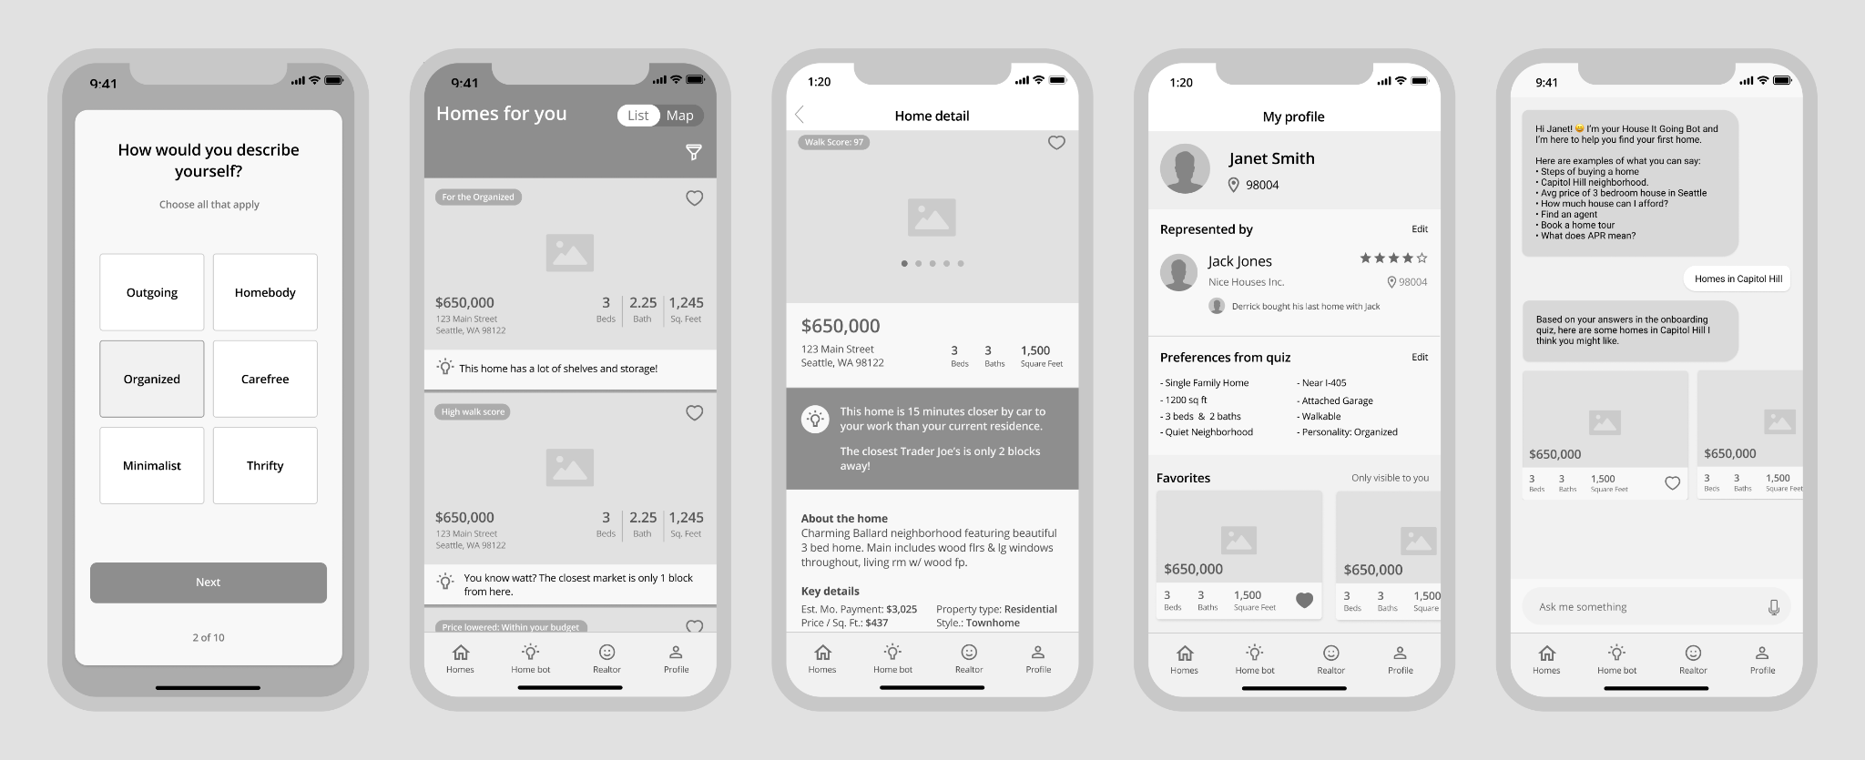
Mid-fidelity prototypes
https://medium.com/the-home-team/homeguide-prototype-portfolio-a8746296e958

Slide 22
6 dimensions of prototypes’ fidelity
The fidelity of a prototype and the activity of prototyping mainly moves on these main 6 dimensions:
Visual/Physical realism: How closely the prototype resembles the final product in terms of visual design and aesthetics.
Scope: The breadth and depth of the design represented in the prototype.
Functionality: What actually works in the prototype, such as links or buttons in a web app.
Data: Whether the prototype operates on real or fake data.
Autonomy: Whether the prototype can operate alone or requires input from the designer or user.
Platform: Whether the prototype is an interim or final implementation.

Slide 23
Scope of prototypes
Say you have decided to test your design and its functionalities through an mid-fidelity prototype.
This gives you information about how good the prototype will look and feel. But how much the user will be able to see and test?
This is a matter of scope of the prototype. There are two possible scopes:
Horizontal
Vertical

Slide 24
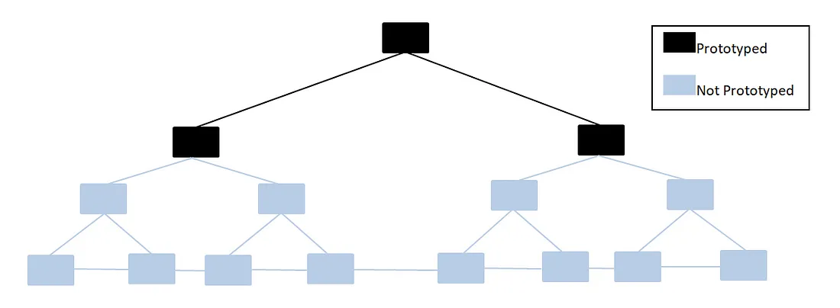
Scope of prototypes: Horizontal
An horizontal prototype gives an entire overview of the system, although not going too much in detail for each feature: you display a wide range of features without actually implementing them. This means that the prototype is constrained to only one layer.
It is useful in the early stages of design as it allows stakeholders to quickly identify potential issues and make design decisions based on feedback from users.

Slide 25
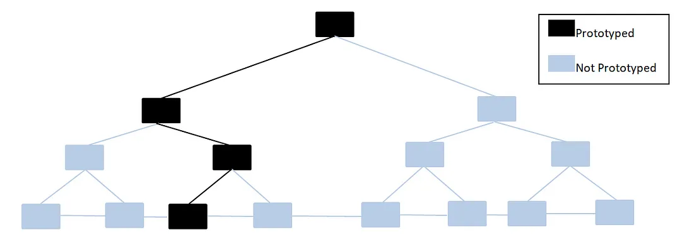
Scope of prototypes: Vertical
A vertical prototype gives a detailed view of a specific feature: you have only one or few features actually designed. This means that the prototype delivers the system and its subsystems.
In this way you can test the technical feasibility of the product or that a specific requirement is fulfilled by the user (in the interaction with the system).

Slide 26
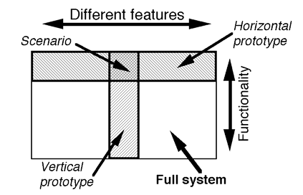
Scope of prototypes

Slide 27
Prototyping techniques

Slide 28
Paper prototypes
A paper prototype is a low-fidelity prototype created on paper or cardboard that represents the basic layout and functionality of a product or service. It's a quick and inexpensive way to test and refine user interface designs before investing time and resources in more high-fidelity prototypes.

Slide 29
Paper prototypes
Creating a paper prototype involves sketching out the basic layout and functionality of a website or app on paper or cardboard. Users can then interact with the prototype by physically manipulating the paper or cardboard, simulating how they might interact with a digital interface.
Paper prototypes can be used to quickly test a wide range of design elements, from the placement of buttons and menus to the flow of information and user interactions. They are particularly useful in the early stages of the design process, when designers are still exploring different design options and gathering feedback from users.

Slide 30
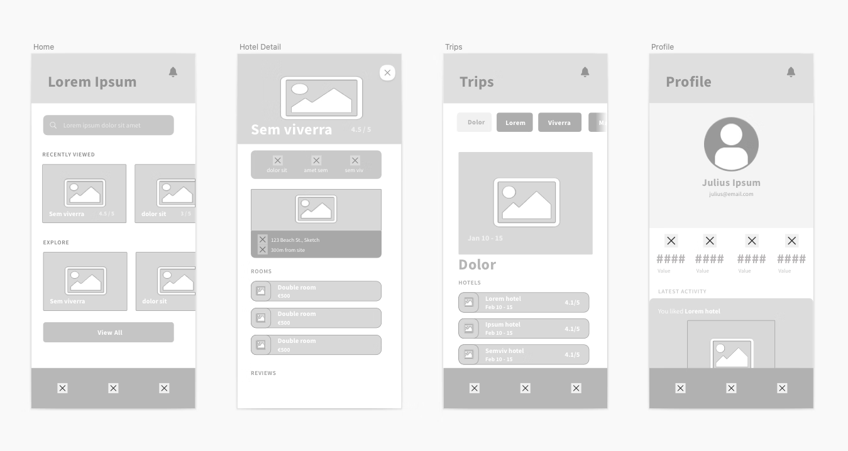
(Mid-fi) Wireframe prototypes
A wireframe prototype is a digital prototype that represents the basic layout and functionality of a product or service, without much detail or visual design. It's a quick and inexpensive way to test and refine the basic structure of a product or service, without getting bogged down in visual details.

Slide 31
(Mid-fi) Wireframe prototypes
Creating a wireframe prototype involves sketching out the basic layout and functionality of a product or service, using simple shapes and symbols to represent different UI elements.

Slide 32
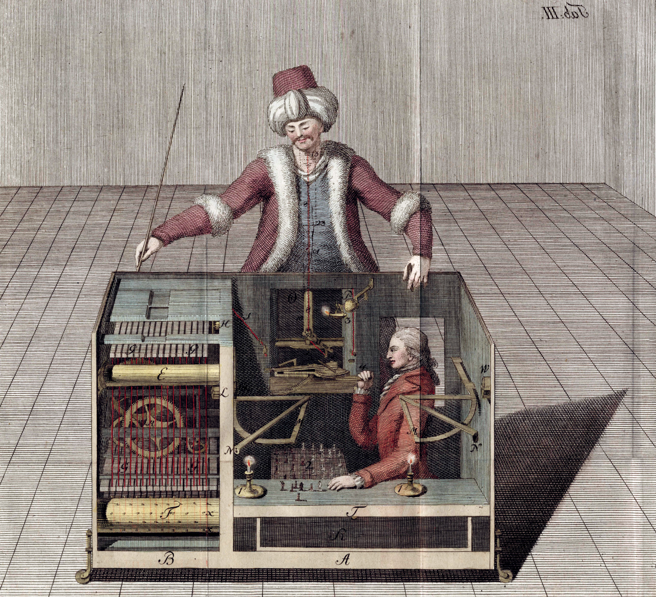
Wizard of Oz (or Mechanical Turk) prototypes
A Wizard of Oz is a prototype that simulates the behavior of a product or service using human input instead of actual technology. It's used to test the user experience of a product or service before actual technology is developed.
https://en.wikipedia.org/wiki/Mechanical_Turk

Slide 33
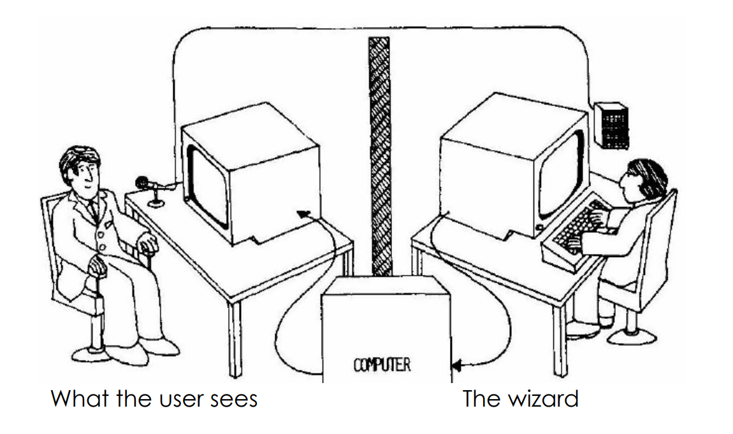
Wizard of Oz prototypes
Creating a Wizard of Oz involves using a human operator or team of operators to simulate the behavior and responses of a product or service. This can involve using pre-recorded audio or video, scripted responses, or even live interactions with users. The goal is to simulate the experience of using a product or service without actually building the technology behind it.
IBM voice editor (1984)

Slide 34
Functional prototypes
A functional prototype is a prototype that includes working or partially working features. It is used to test and refine the technical aspects of a product, such as the responsiveness and functionality of different features.

Slide 35
Functional prototypes
Creating a functional prototype involves building a prototype with actual code and programming, or using a prototyping tool that allows for interactive elements and functionality.
They are particularly useful in the later stages of the design process, when designers are looking to fine-tune the technical details of their designs before moving on to full development.

Slide 36
Non-Functional prototypes
A non-functional prototype is a prototype that looks and feels like a real product or system but does not have any functional capabilities. It is typically used to demonstrate the physical design and user interface of a product or system, without the need for any actual working components or systems.
They are typically used to test the design and user experience of a product or system before investing resources into building a functional prototype. A little coding can be still necessary, but without going too much in detail and without real working functionalities or at least just superficially: for example, you have the website and its navigation working but without an actual backend service.
https://www.youtube.com/watch?v=2CTMJxWh5w4

Slide 37
Non-Functional prototypes
There are several ways that non-functional prototypes can be used for testing:
Testing User Experience: can be used to test the user experience (UX) of a product or system. This involves testing how users interact with the prototype, how easy it is for them to navigate and use, and whether it meets their needs and expectations.
Testing Visual Design: can also be used to test the visual design as an advanced mockup with some interaction. This involves testing the aesthetics, layout, and overall look and feel of the prototype, and whether it is visually appealing and consistent with the brand identity.

Slide 38
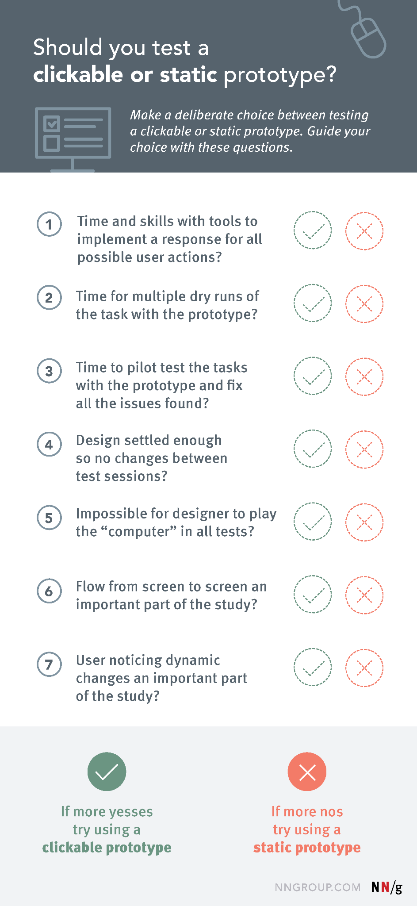
Clickable or static prototype?

Slide 39
Wireframes
vs
Mockups
vs
Prototypes

Slide 40
Wireframes vs Mockups vs Prototypes
People often confuse the concept of mockups with that of prototypes. However, prototypes are more advanced versions of mockups that include navigation and functionality, allowing for more meaningful testing and feedback from users.
Designers usually use mockups and wireframes to first create prototypes that simulate the functionality and user experience of the final product.
The prototypes are then used to test and validate the design before moving on to the development phase.

Slide 41
Wireframes vs Mockups vs Prototypes
Has visual design, colors, typography and images?
Is it clickable and interactive?
Can respond to actions in other ways ?
NO
NO
NO
YES
YES
YES
Functional Prototype
Functional Prototype
Mockup
Wireframe

Slide 42
From wireframe to mockups to prototypes
Lo-fi wireframe
early design
Paper prototype
Hi-fi wireframe
Mid-fi prototype
Mockup
Hi-fidelity prototype
late design
Working System

Slide 43
Prototyping tools

Slide 44
Tool | Main Features | Platforms | Price
Figma | Collaborative design tool, Vector Networks, Auto Layout, Prototyping, Developer Handoff, Version History | Web-based | Free for individuals (limited features), 12€/month per editor for Professional plan (free for students!)
Sketch | Vector-based design tool, Libraries, Prototyping, Plugins, Handoff | macOS | 9€/month per editor
Adobe XD | Vector-based design tool, Auto-Animate, Prototyping, Plugins, Developer Handoff, Voice Prototyping, Collaboration | Windows, macOS | 12.19€/month per editor for Single App plan
InVision | Design System Manager, Prototyping, Collaboration, User Testing, Animations, Inspect | Web-based | Free for individuals (limited features), $4.95/month per user for Starter plan (for collaborative teams)

Slide 45
and others: Axure, Marvel, Principle, Flinto, ProtoPie, Proto.io, UX Pin, …

Slide 46
Figma

Slide 47
Introduction - What is Figma?
Figma is a web app that helps designers build wireframes, mockups, prototypes and so on.
Some advantages:
The professional plan is free for students.
Many collaboration features.
Plugins and community.
https://help.figma.com/hc/en-us/categories/360002051613-Get-started

Slide 48
Layers on FIgma
Layers work differently on Figma respect Illustrator or other drawing software you may know.
But understanding how to use them is simple:
Every object in the scene is a layer.
If you group many objects together they make a layer.
If you place them in a frame, the frame itself is a layer with many sub-layers.
In addition to this you can use pages to better organize your workplace.

Slide 49
Some basic but useful shortcuts
When moving objects:
Shift + mouse move: snap to other objects.
Alt + mouse move: copy and paste object (on release).
You can use them together.
When resizing objects:
Shift + drag borders: resize maintaining aspect ratio.
Alt + drag borders: resize maintaining center position.
You can use them together.

